Slide 1

Personality Quiz Application
Emily Harrison

Slide 2
This Android application will be a combination of multiple personality tests into one

Slide 3
The app will be created with Visual Studio 2019 using C#

Slide 4
The application will include :
Home screen
Test Page
Information Page
etc.

Slide 5
Some of the personality tests included are:
Myers Briggs Test
Enneagram Test
DiSC Test

Slide 6

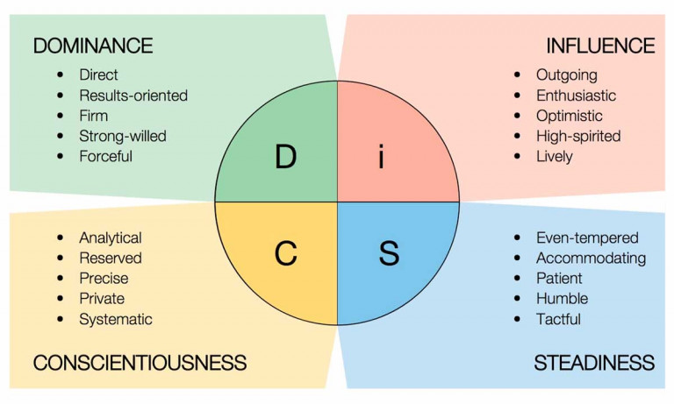
DiSC Test

